Slide 1
Richa Singh
IBM-No-Attrition-DataSet
11-27-2018

Slide 2
Dataset
The IBM-No-Attrition Dataset consists of:
1233 Observations and 32 variables
Qualitative : Attrition, BusinessTravel, EducationField, Gender, JobRole, MaritalStatus,OverTime
Quantitative:Sub,Age,Monthly Income,Daily Rate,Hourly Rate, MonthlyRate, DistanceFromeHome, PercentSalaryHike, TotalWorkingYears, TrainingTimesLastYear, WorkLifeBalance, WorkLifeBalance, YearsAtCompany, YearsInCurrentRole, YearsSinceLastPromotion,YearsWithCurrManager
Ordinal: PerformanceRating, Education, JobInvolvement, Joblevel, StockOptionLevel,EnvironmentSatisfaction, JobSatisfaction, RelationshipSatisfaction
Research Question: How do all 1233 HR-IBM Employees differ on the variables like Gender type vs Department ? Job level vs MonthlyIncome ? etc.Explore important questions such as ‘show me a breakdown of distance from home by job role’ or ‘compare average monthly income by education’. This is a fictional data set created by IBM data scientists.

Slide 3
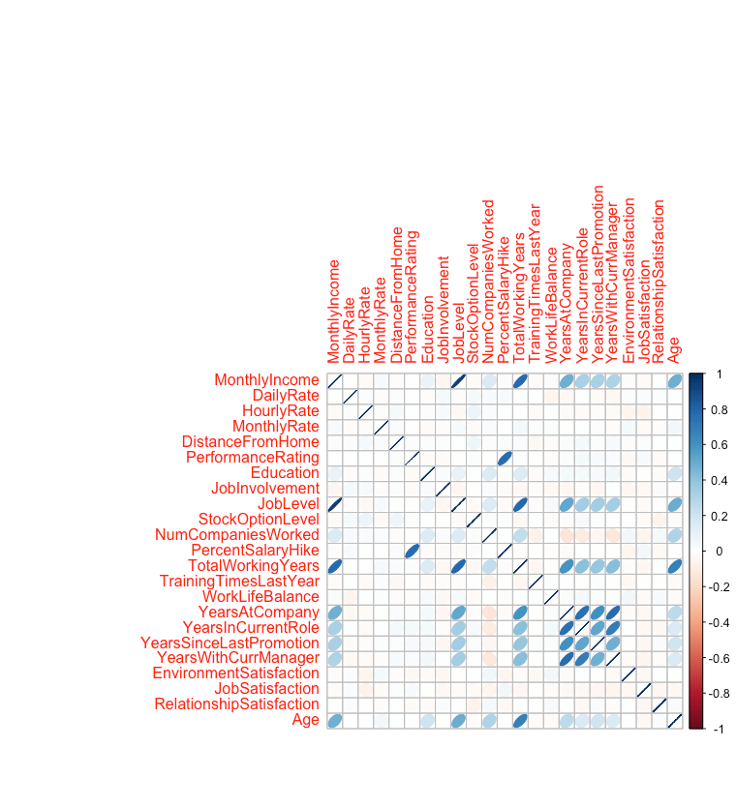
Correlation Plot

Slide 4
MCA

Slide 5
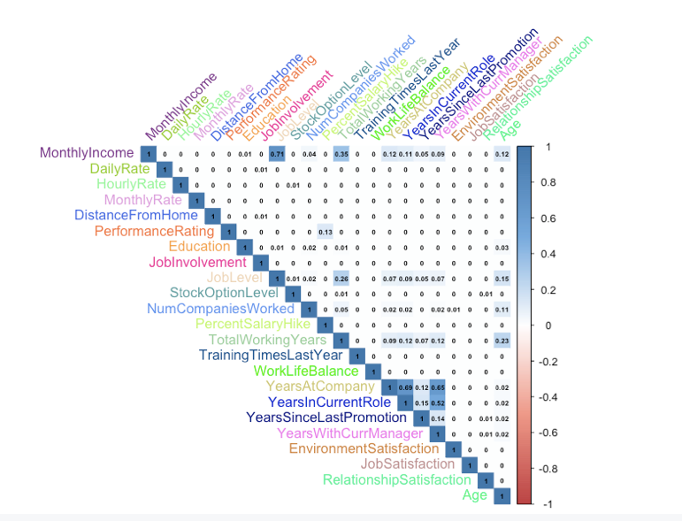
HeatMap

Slide 6
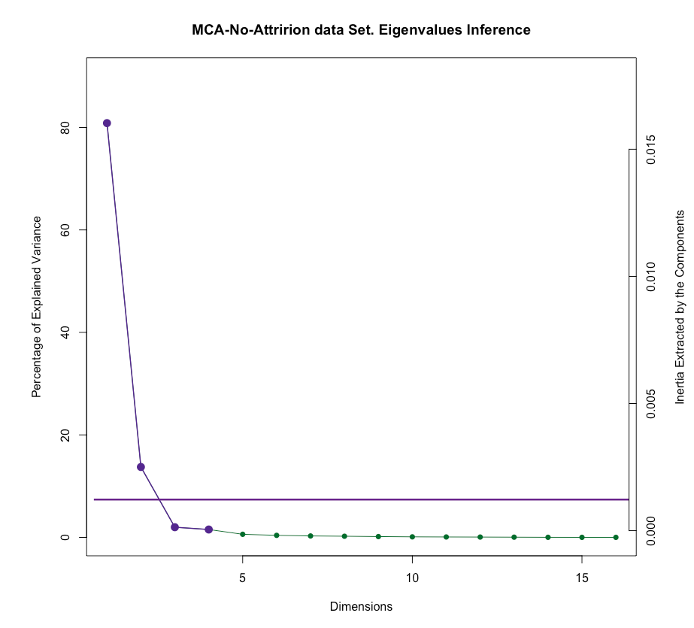
Scree-Plot

Slide 7
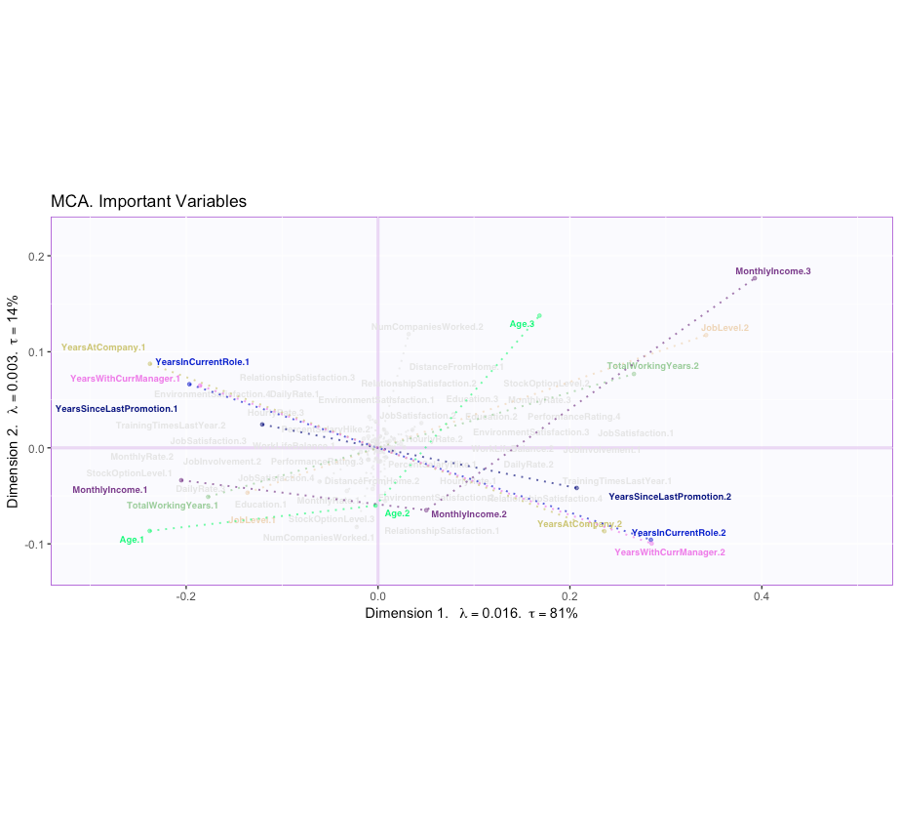
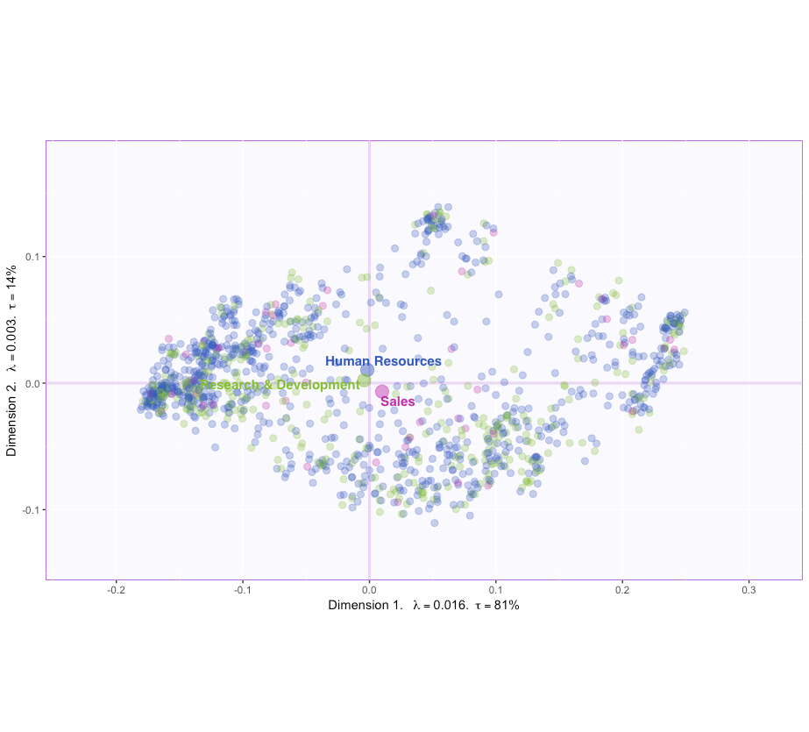
Factor Scores & Loadings

Slide 8
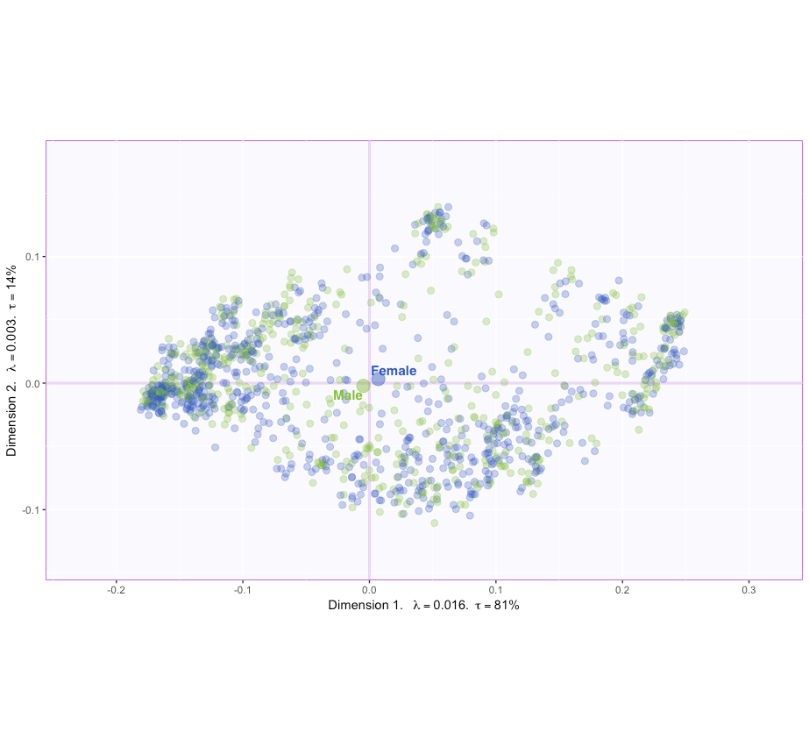
Factor Scores & Loadings

Slide 9
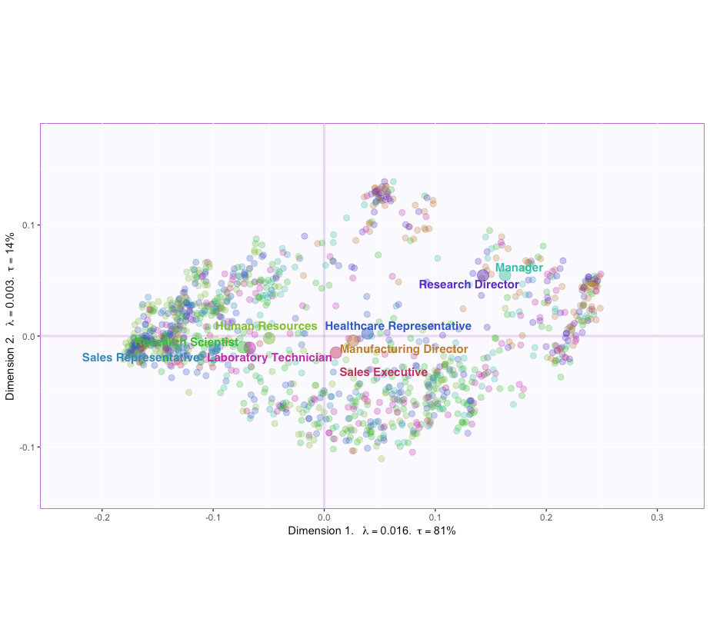
Factor Scores & Loadings

Slide 10
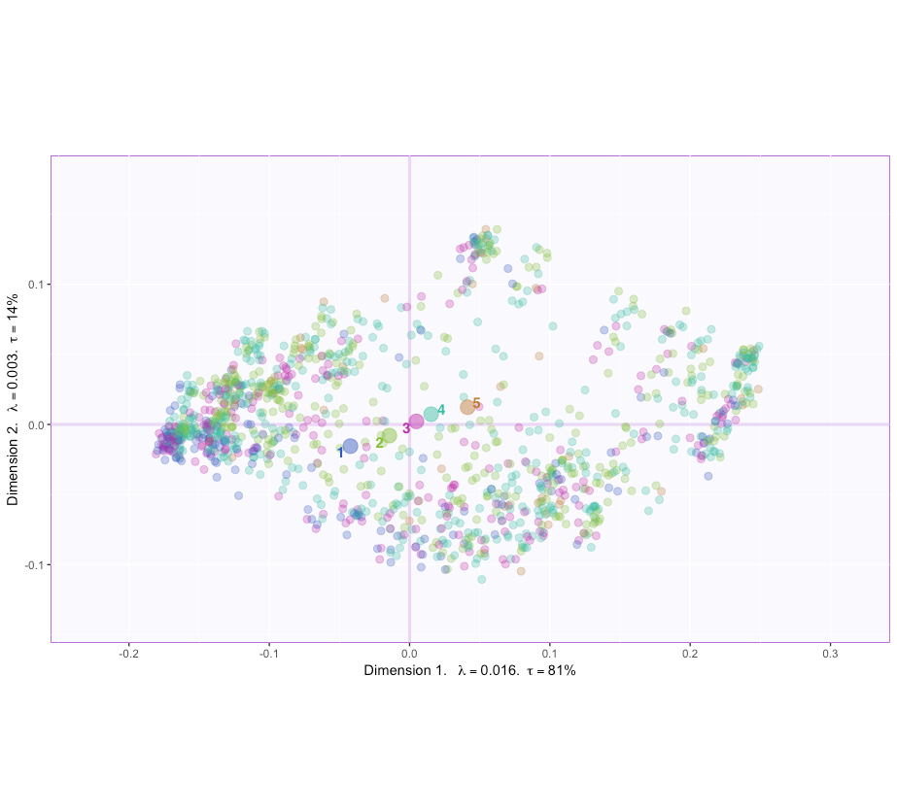
Factor Scores & Loadings

Slide 11
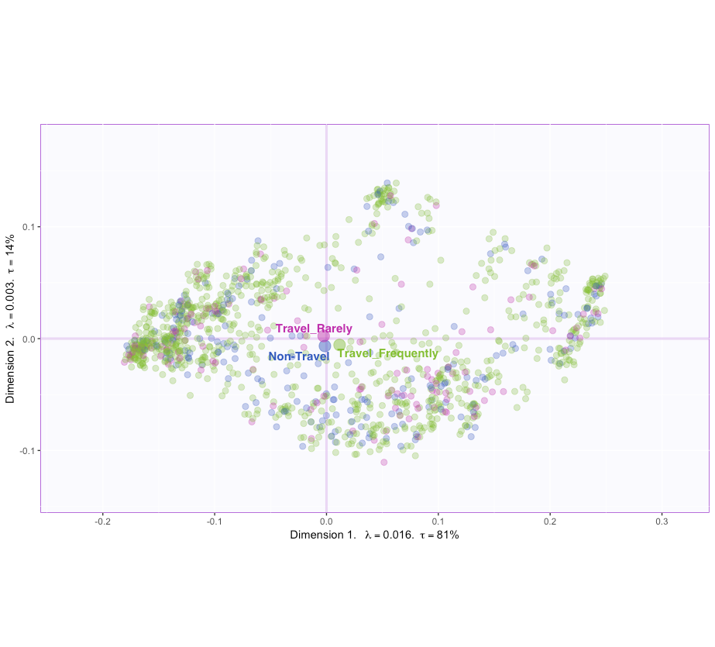
Factor Scores & Loadings

Slide 12
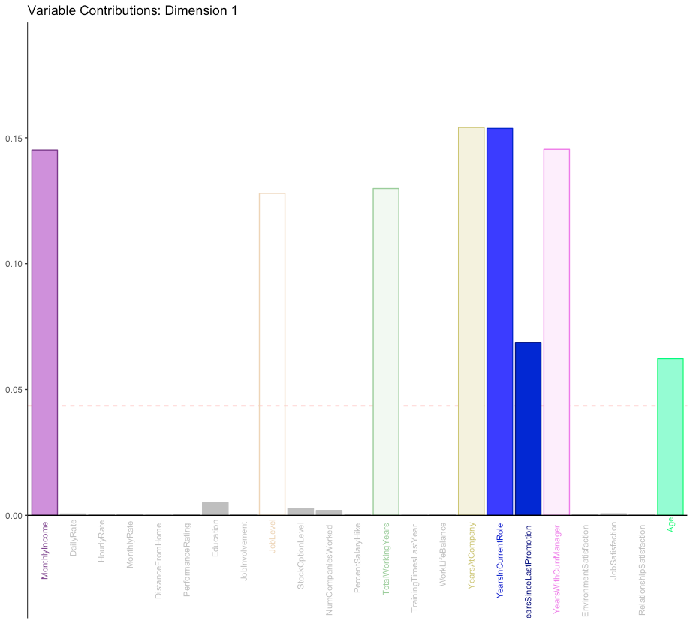
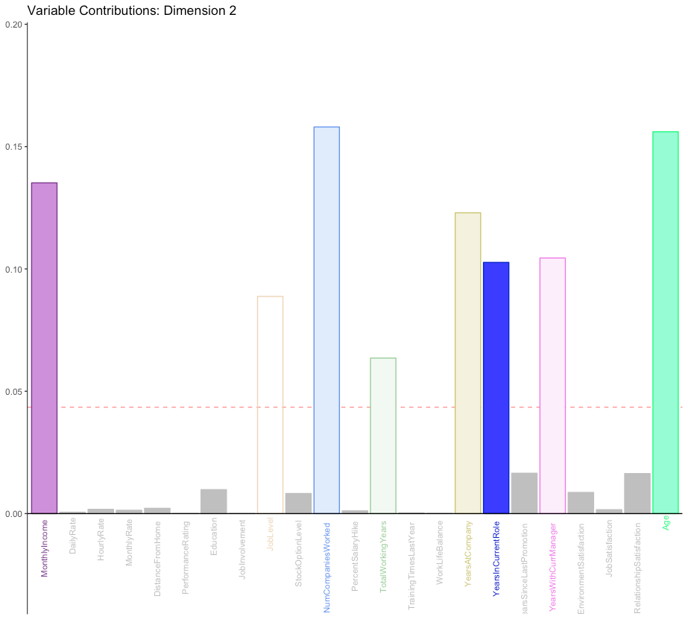
Contributions

Slide 13
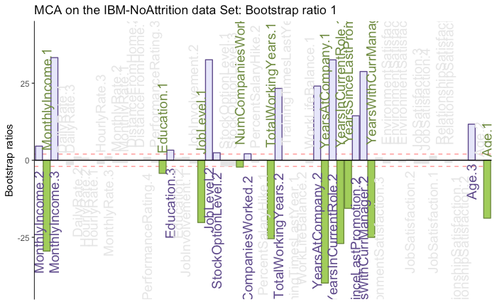
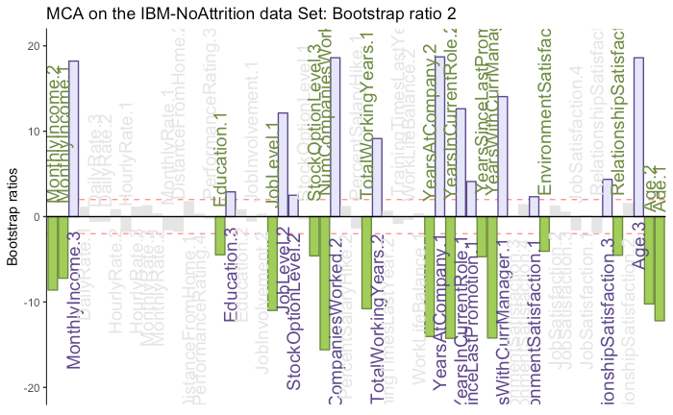
Bootstrap Ratios

Slide 14
Conclusion
For loadings we see that Monthly Income, Job Level, Number of Years are the important variables for the first component and for second component Percentage Salary, Percentage Salary Hike are an important component
For the factor plot the gender type does not show any significant inference as the mean are almost overlapping each other and for the department type similar results can be seen as R&D, Sales and HR all intersect their mean confidence Intervals.

Slide 15
PLS

Slide 16
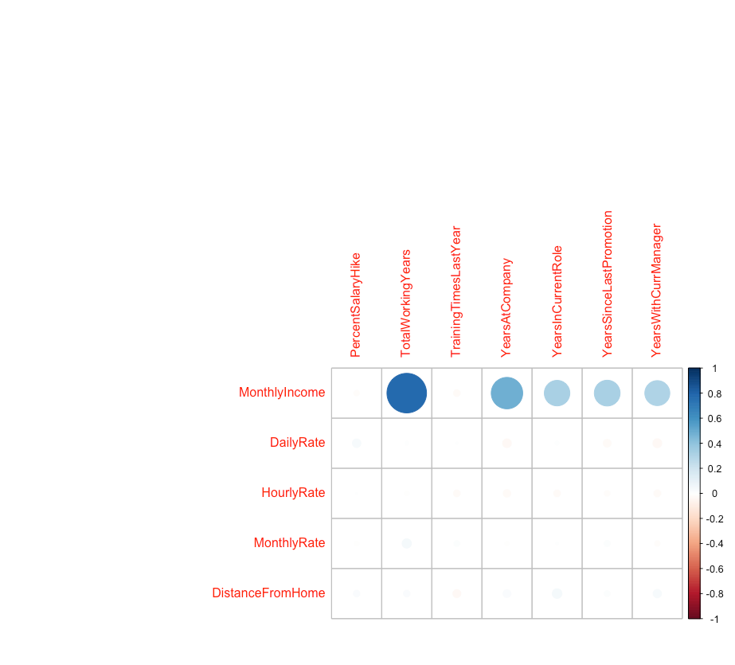
HeatMap

Slide 17
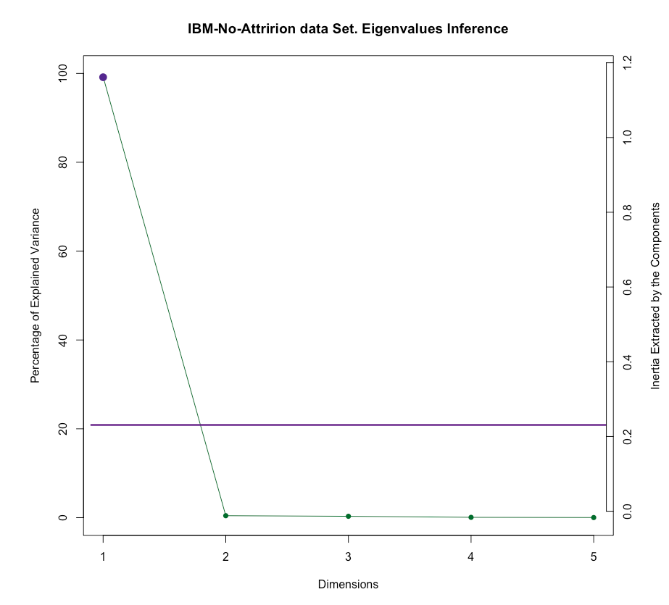
Scree-Plot

Slide 18
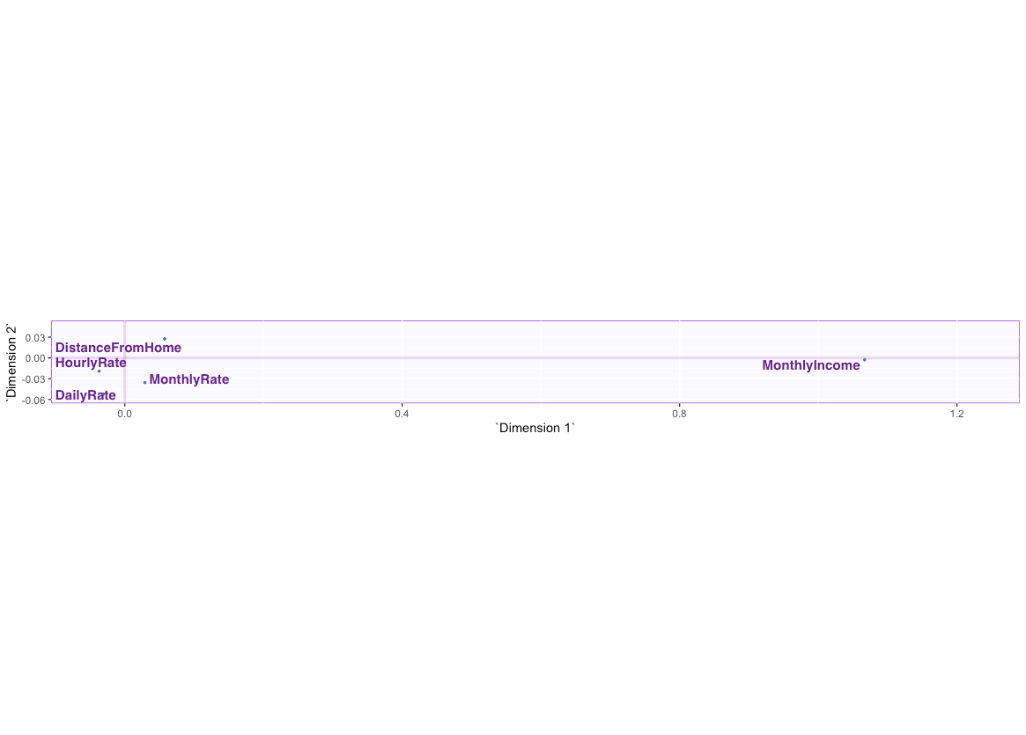
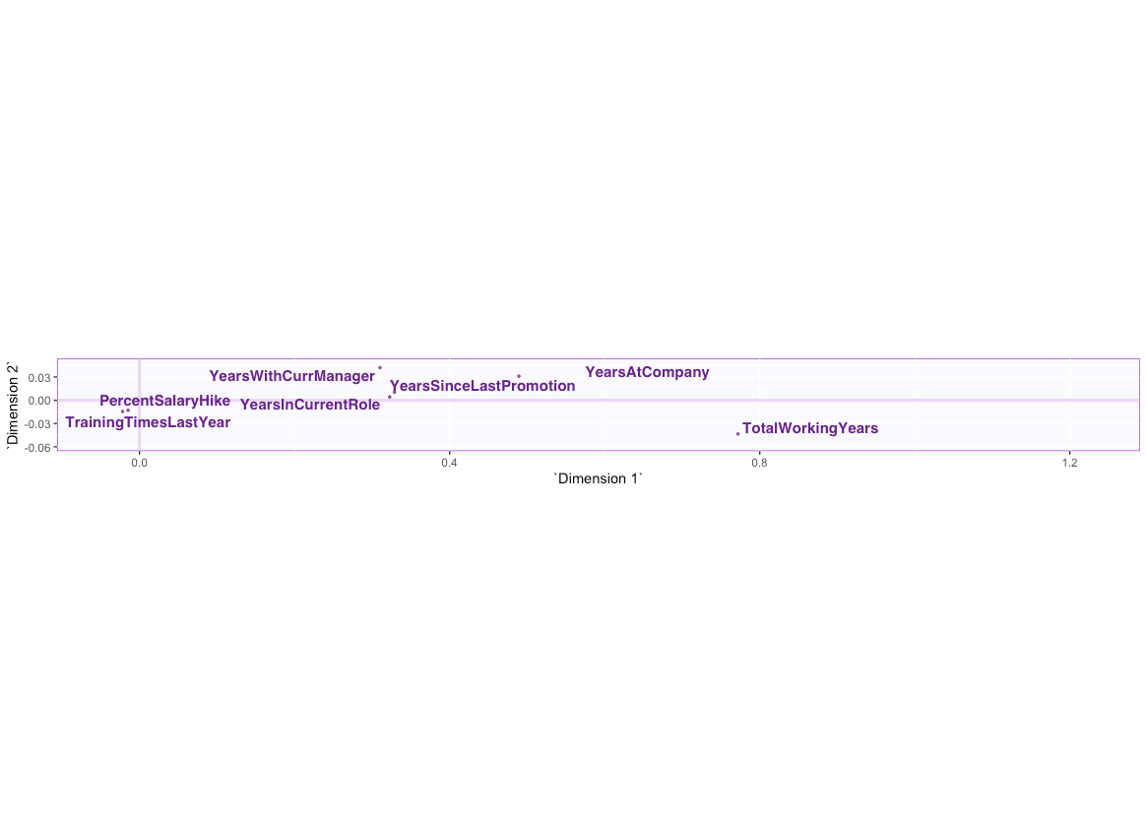
Salience (fi) & Salience (fj)

Slide 19
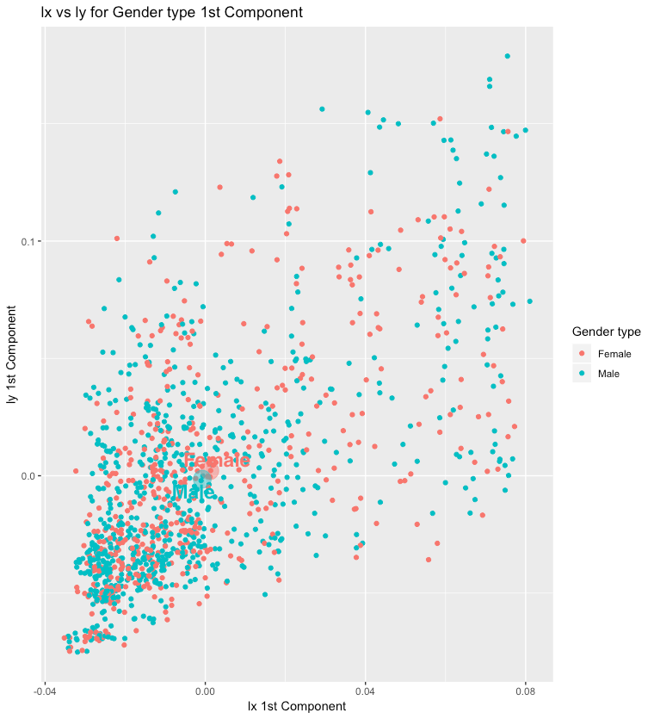
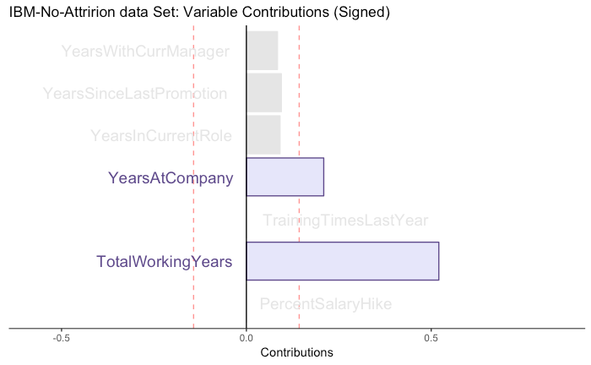
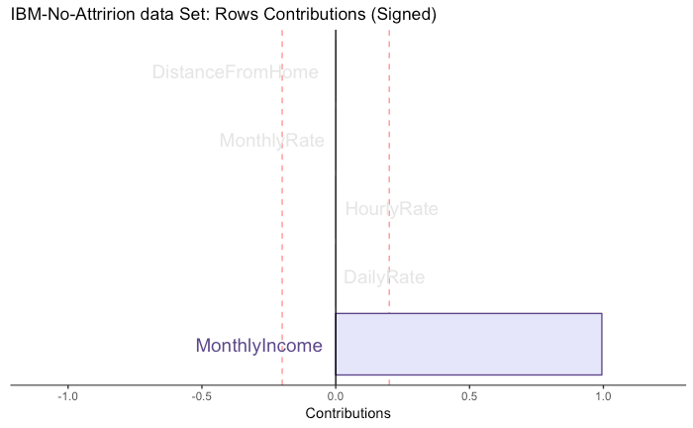

Slide 20
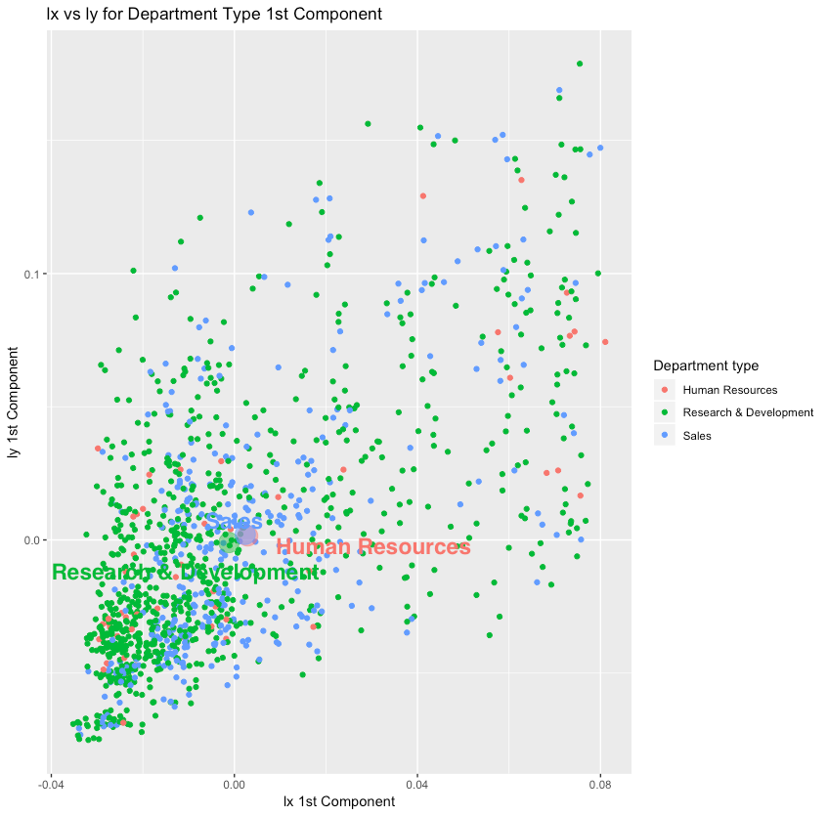

Slide 21
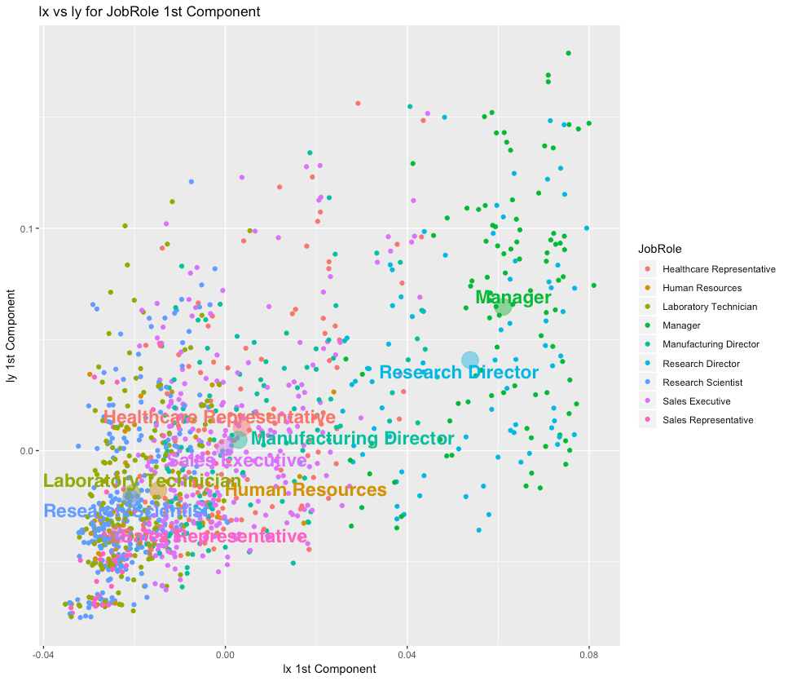

Slide 22
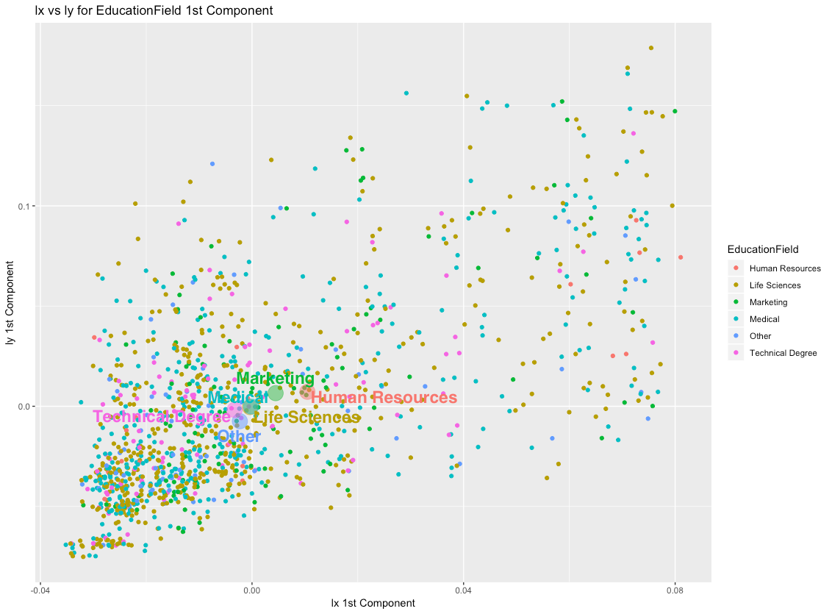

Slide 23
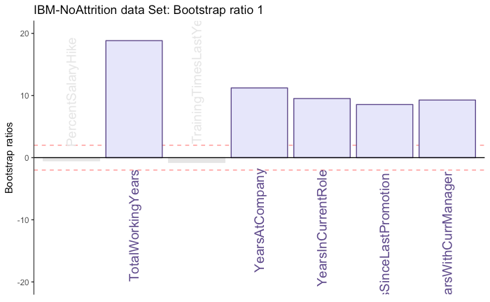
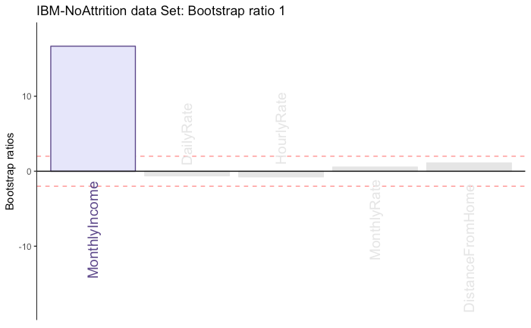
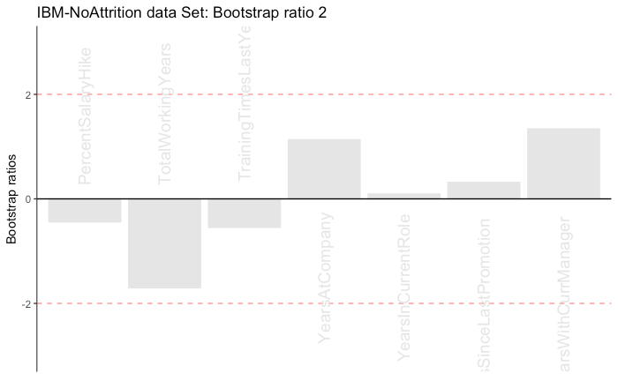
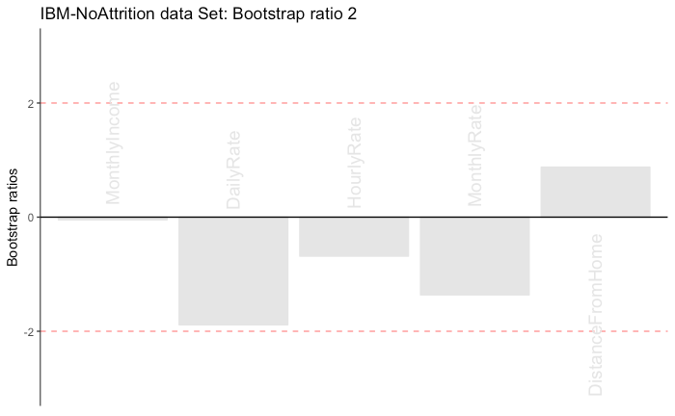
Bootstrap Ratios

Slide 24
Conclusion
Component 1
No significant difference between the gender type Females and Males
No significant difference between the department types HR , Sales and Research & Development
Managers and the Research Directors have high monthly income and high years of experience for the Job Role
No significant difference for the Education field type
Component 2
No significant difference between Females and Males
No significant difference between the department types HR , Sales and Research & Development
No significant difference between the Job Role of different people
No significant difference for the Education field type

Slide 25
DiCA

Slide 26
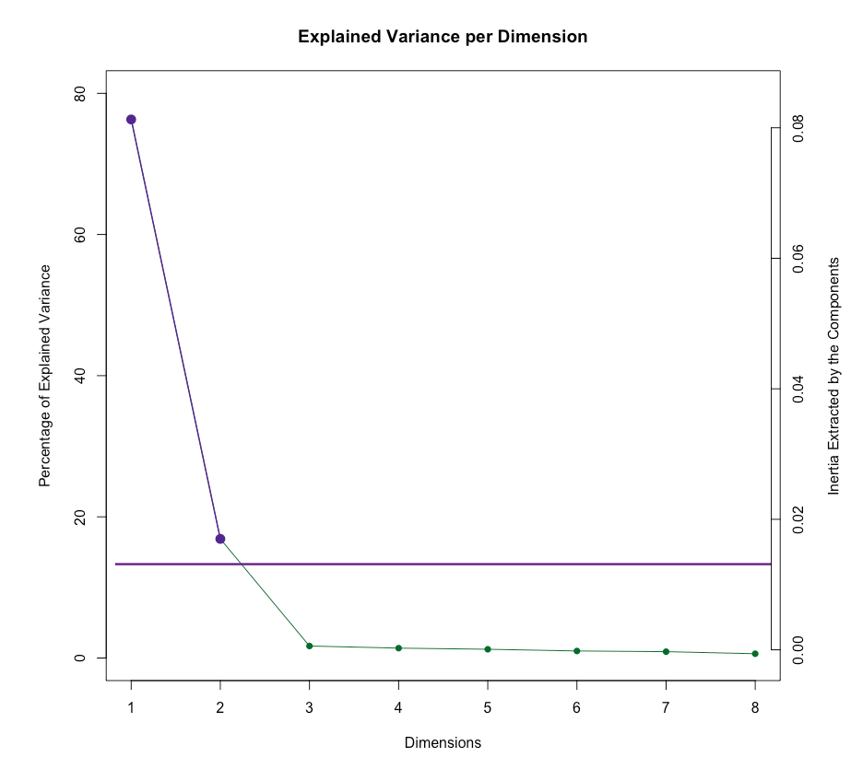
Scree-Plot

Slide 27
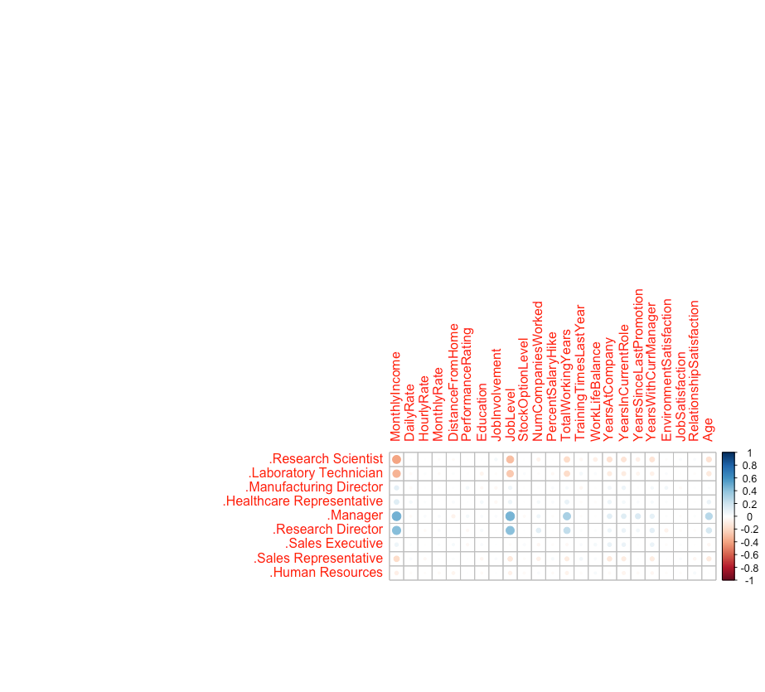
Heat-Map

Slide 28
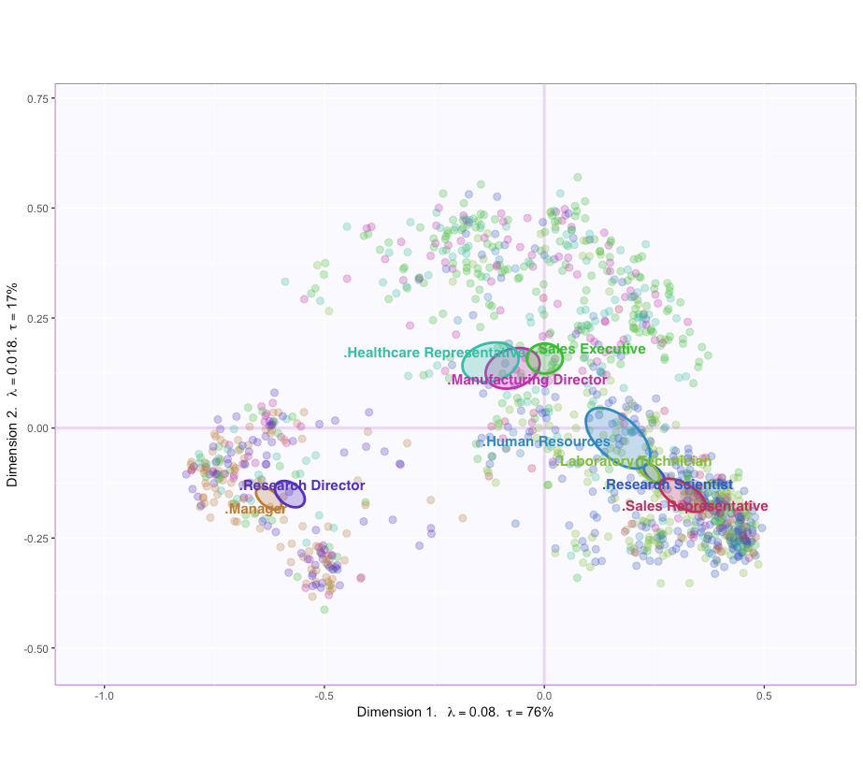
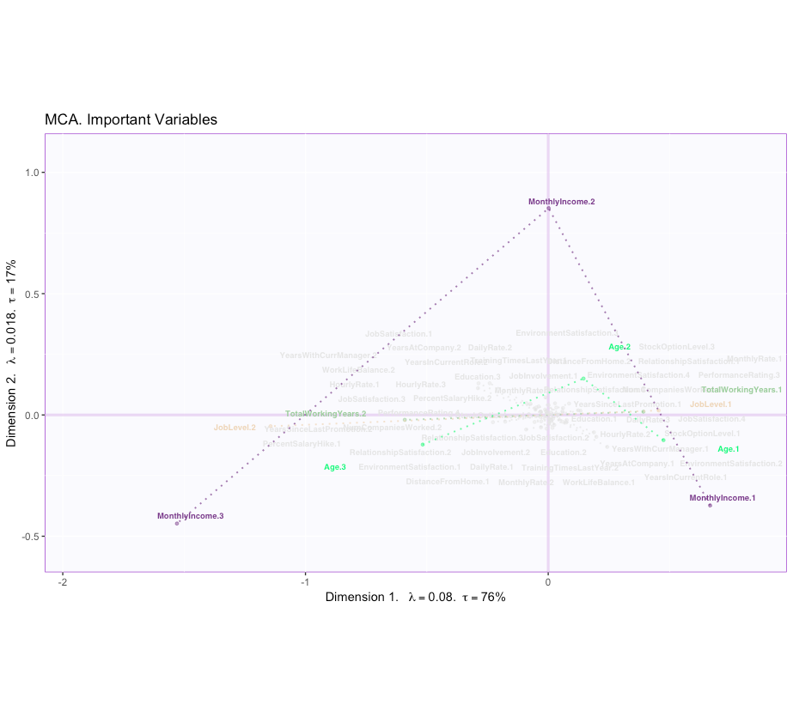
FactorScores & Loadings

Slide 29
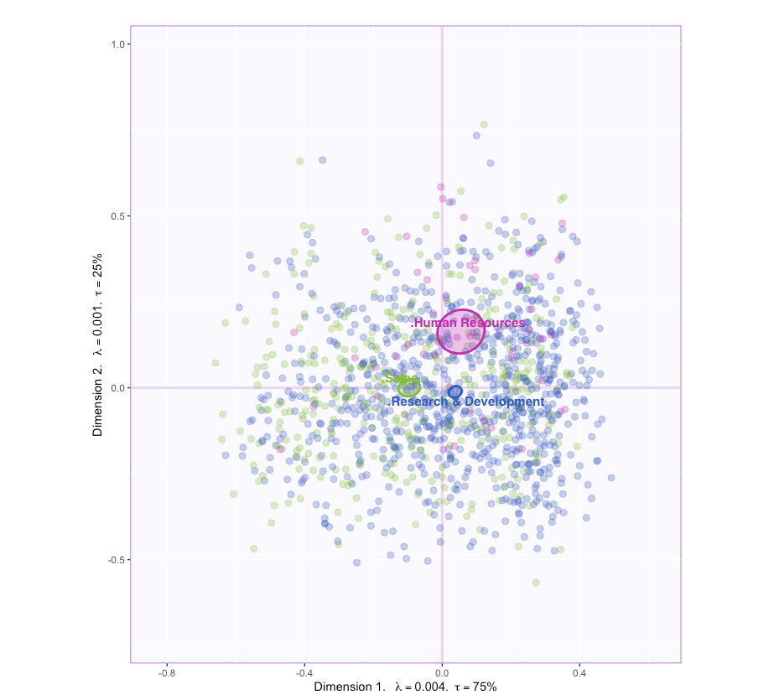
FactorScores & Loadings

Slide 30
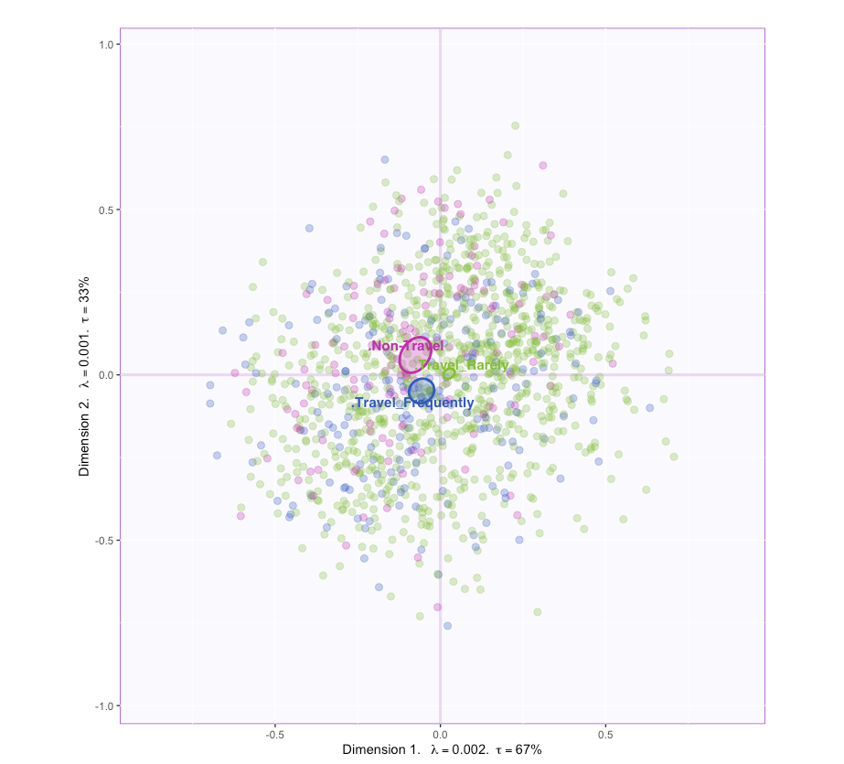
FactorScores & Loadings

Slide 31
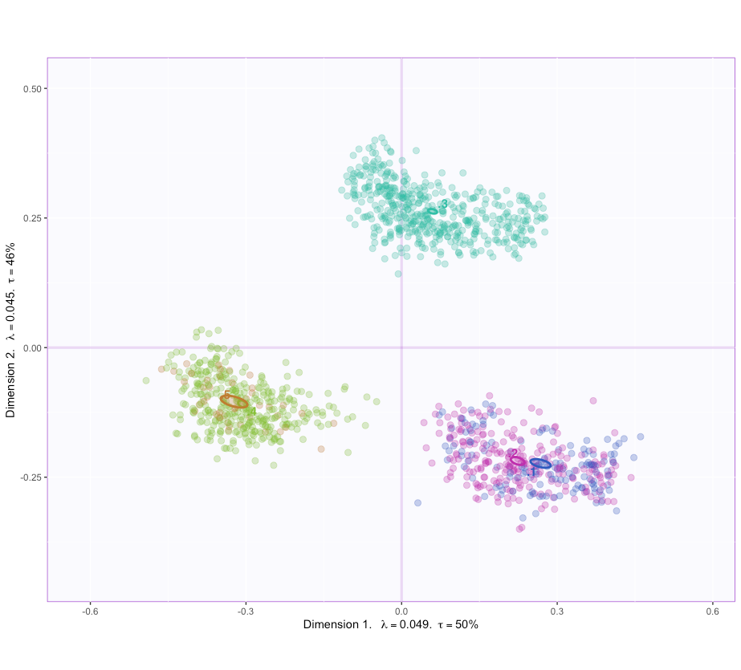
FactorScores & Loadings

Slide 32
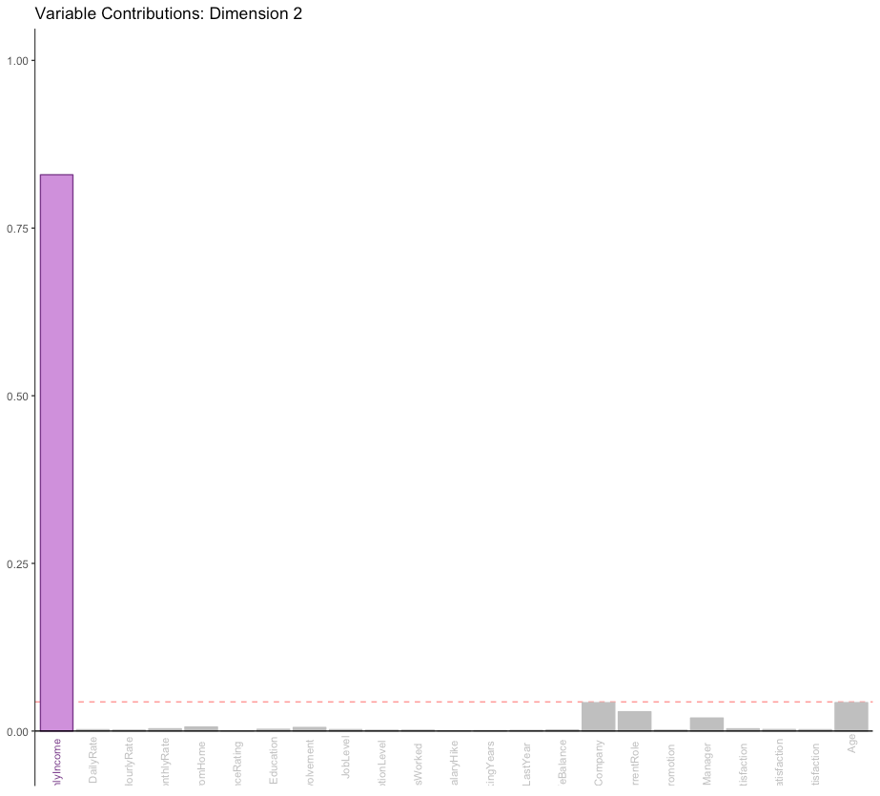
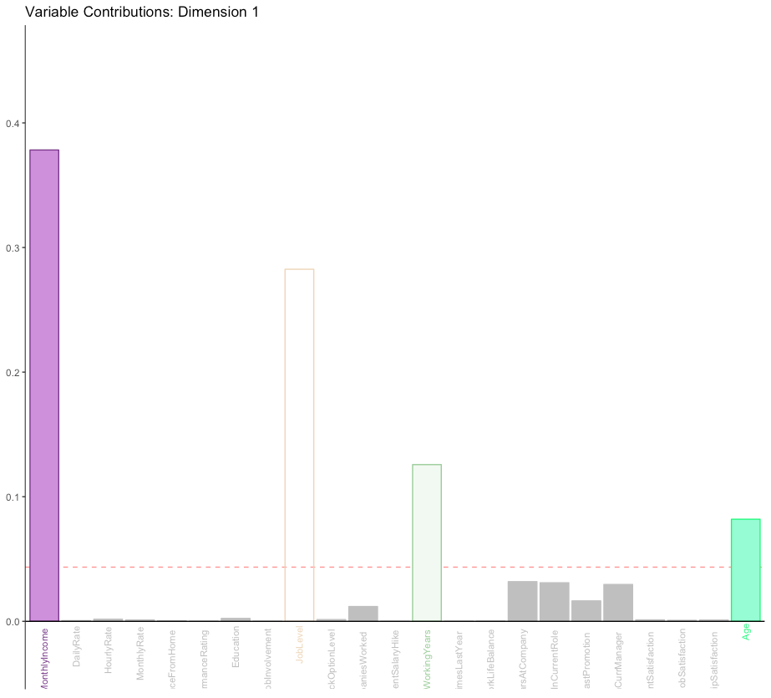
Contributions

Slide 33
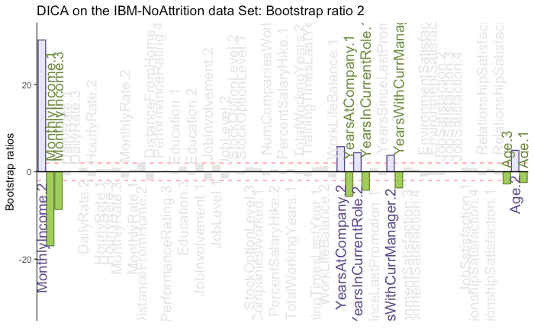
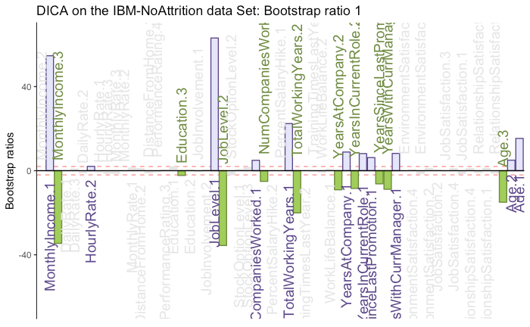
Bootstrap Ratio

Slide 34
Conclusion
Component 1:
- We can say that the Research Director, Manager, Research Scientists have high Income and higher experience in comparison to other Job Roles. Also, we can say that the Sales People have least Income and less number of experience.
Component 2:
- We can also say that component 2 divides HR vs Sales and Research & Development telling that the HR people are generally older with higher income.

Slide 35
MFA

Slide 36
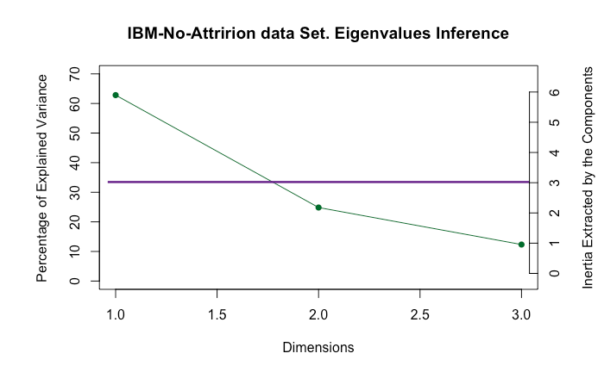
Scree plot

Slide 37
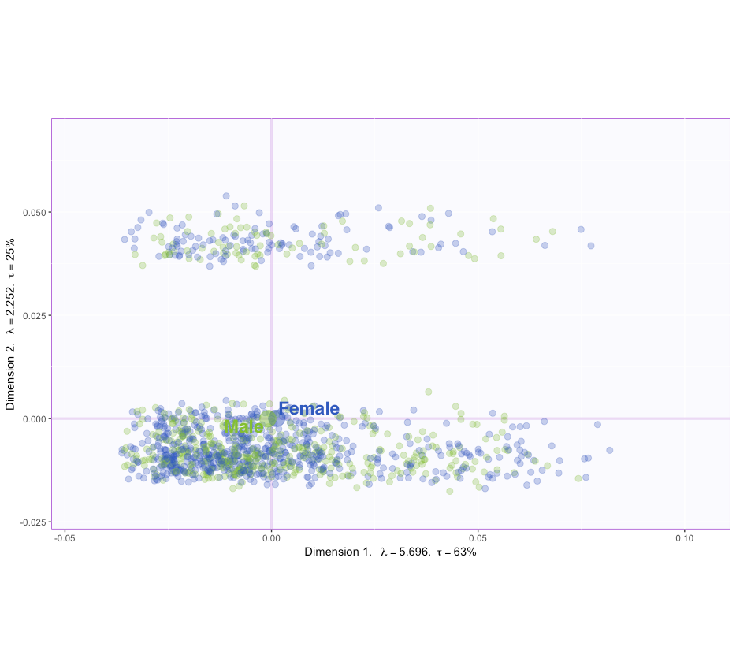
Factor scores

Slide 38
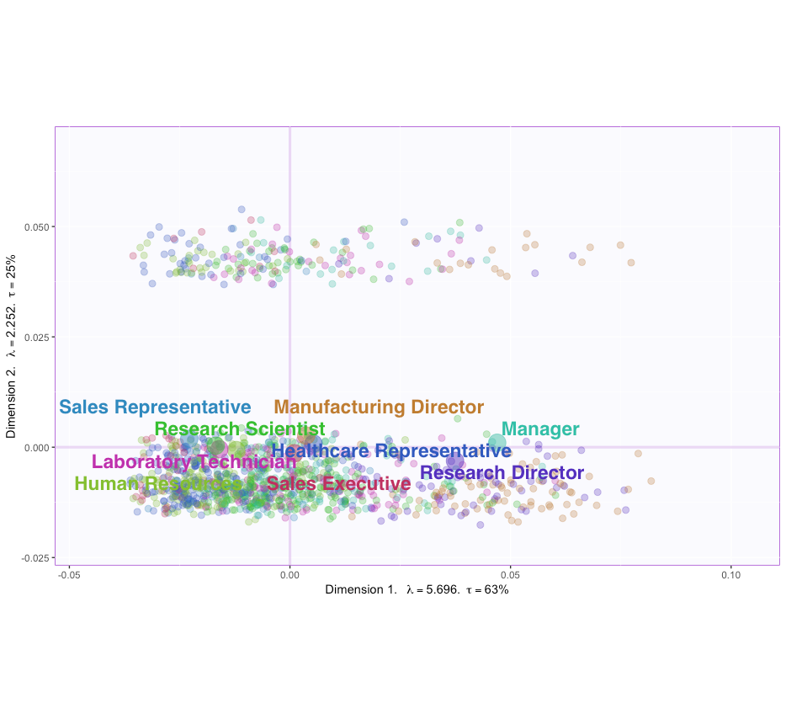
Factor scores

Slide 39
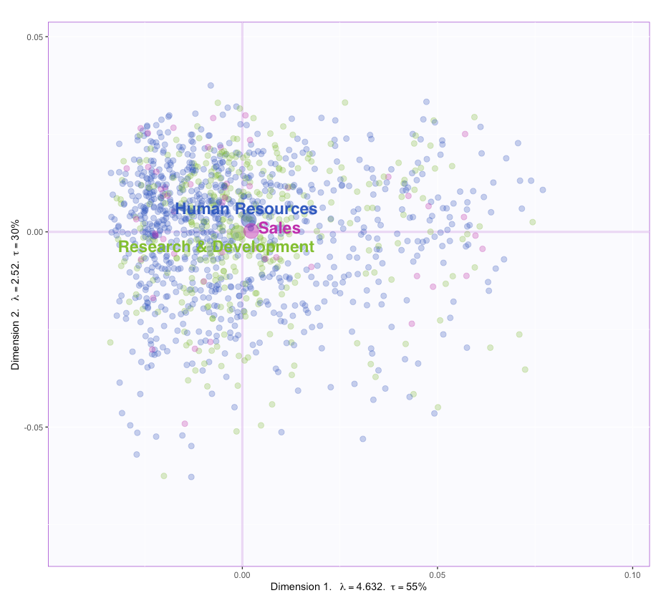
Factor scores

Slide 40
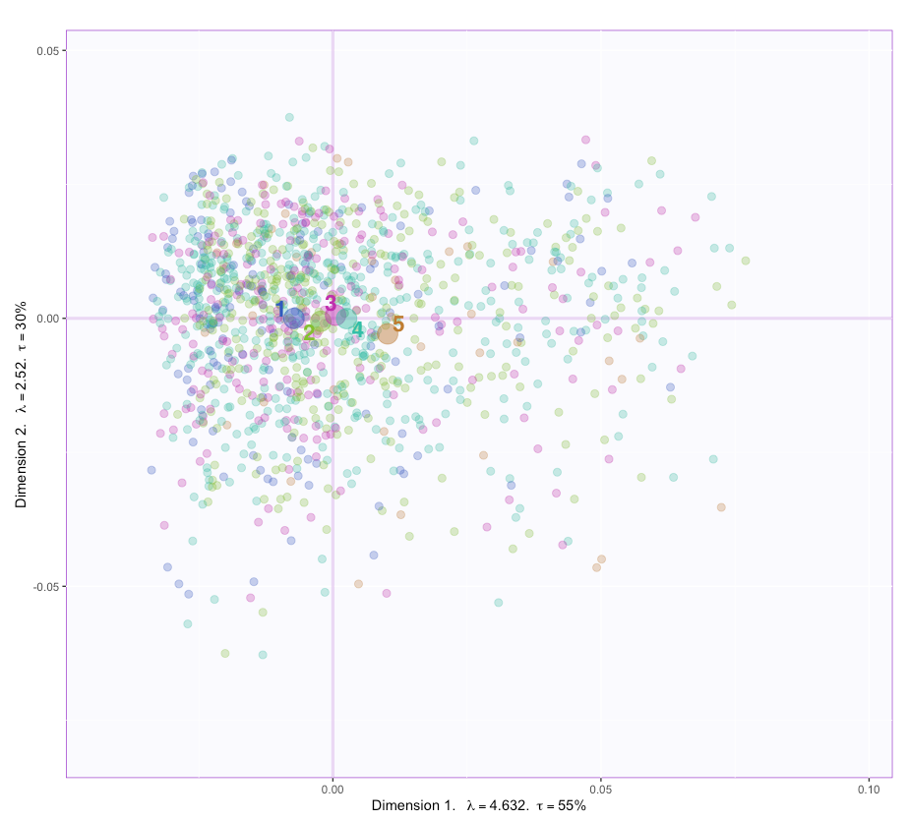
Factor scores

Slide 41
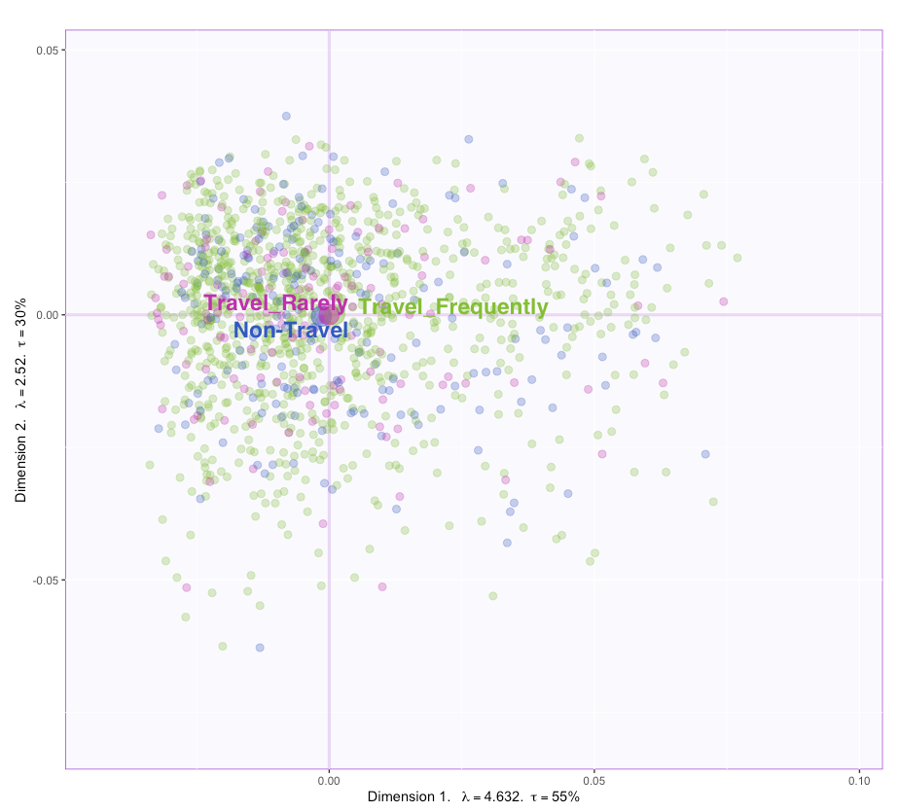
Factor scores

Slide 42
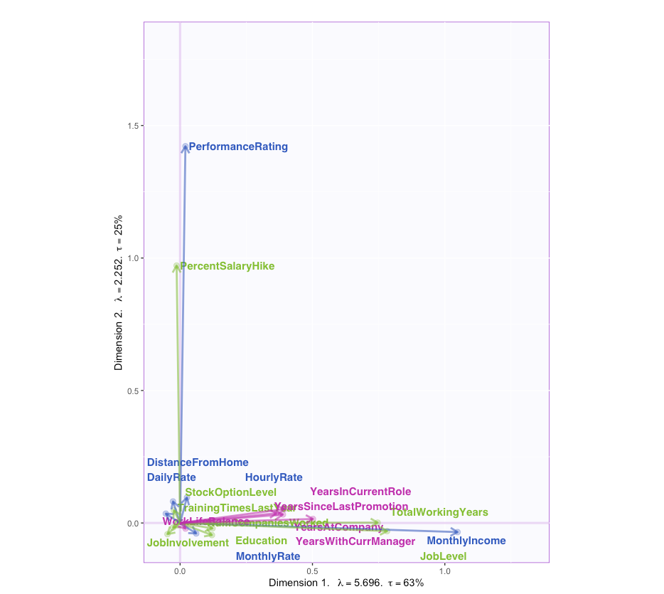
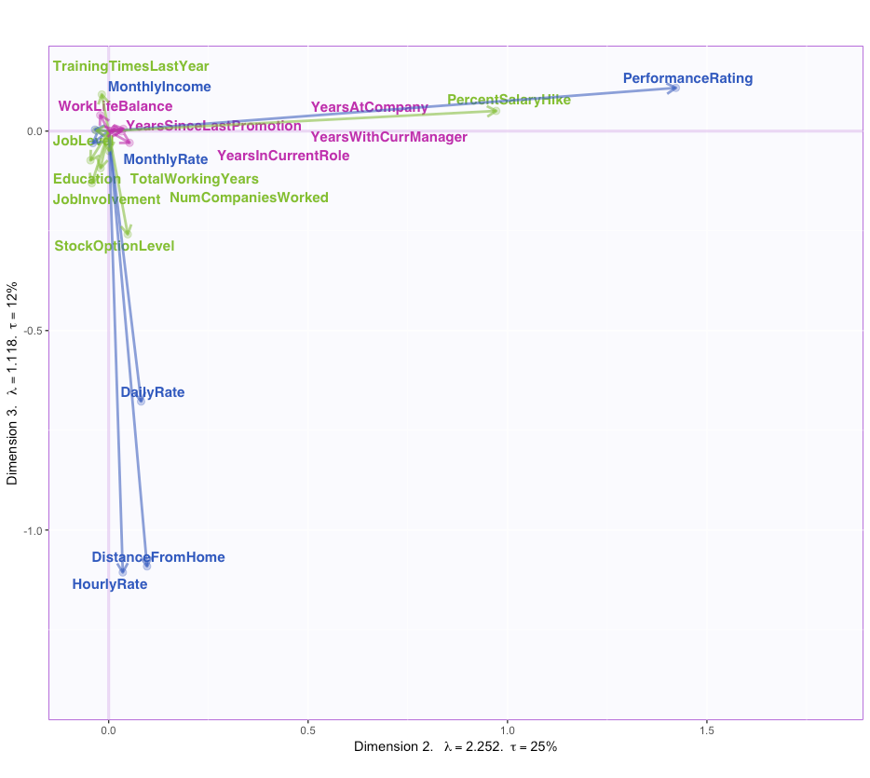
Loadings

Slide 43

Bootstrap Interval

Slide 44

Bootstrap Interval

Slide 45
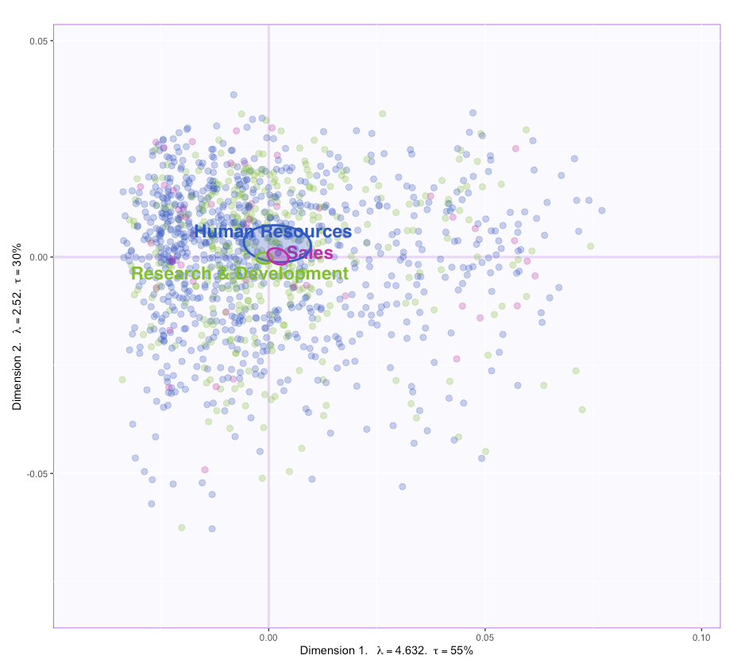
Bootstrap Interval

Slide 46
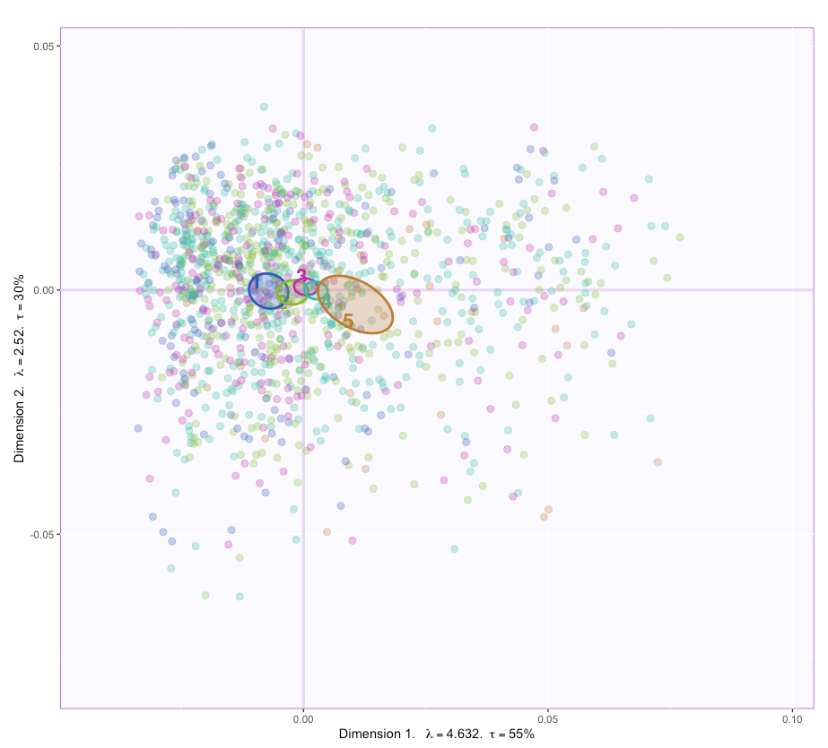
Bootstrap Interval

Slide 47
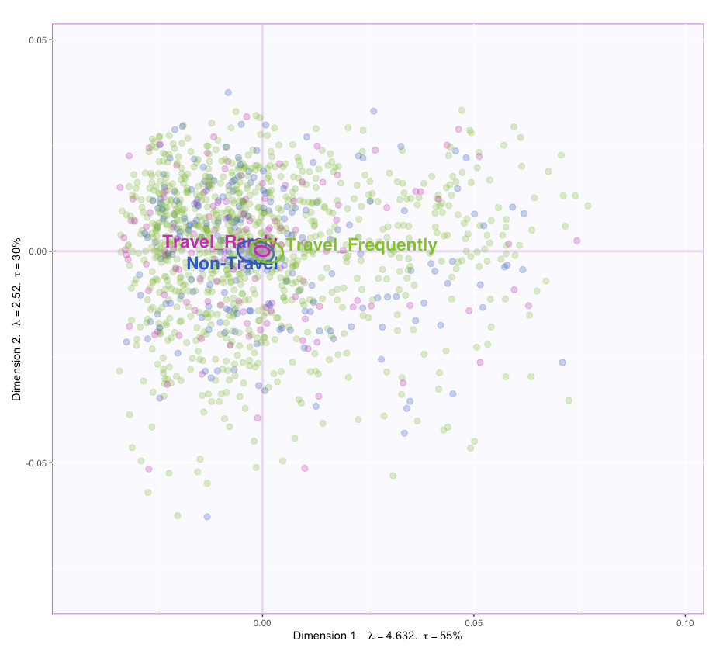
Bootstrap Interval

Slide 48
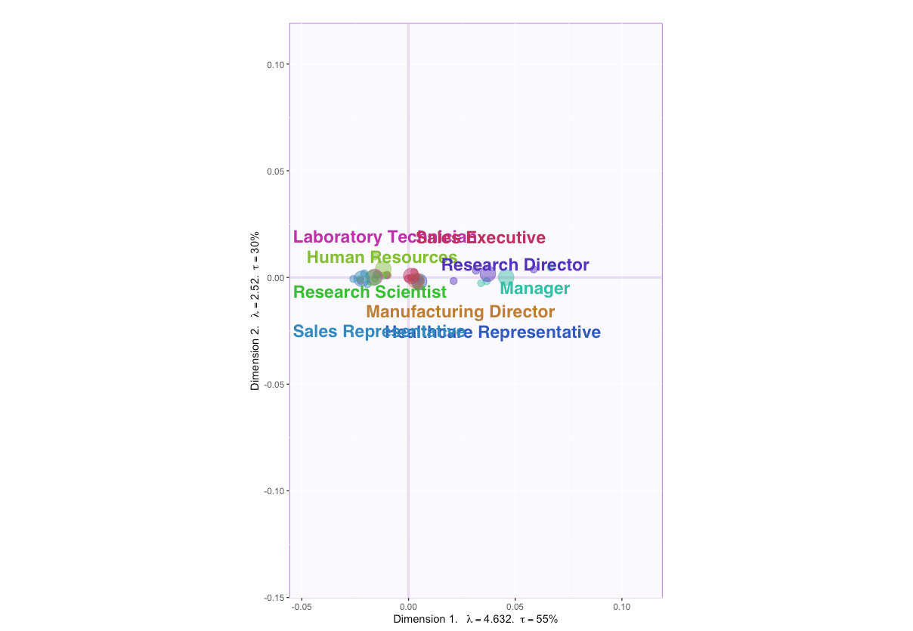
Partial-Factor Scores

Slide 49



Contributions

Slide 50


Bootstrap Ratios

Slide 51


Bootstrap Ratios

Slide 52
Conclusion
People who are Research Director and Manager have high Monthly Income and Job-level with more number of experience
No significant inference can be concluded with the gender type affecting monthly income or Job level
Sales Representative group has the lowest Income with less years of experience

Slide 53
Questions or comments?

